Slide 1
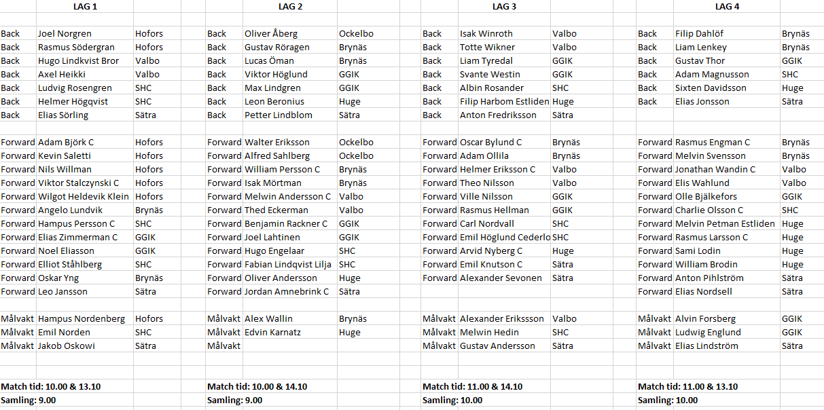
Matchcamp 24/2-20

