Slide 1
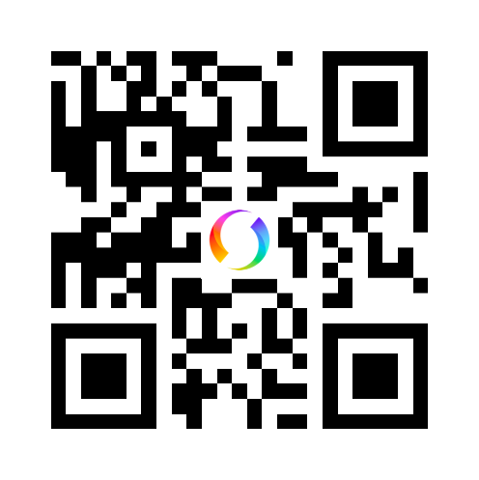
IBF Örebro DJ
076-329 38 63

