Slide 1
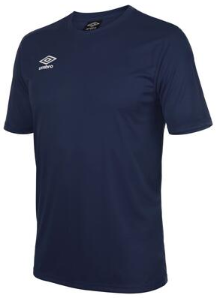
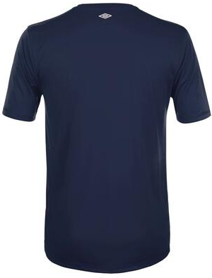
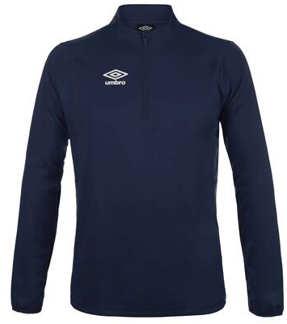
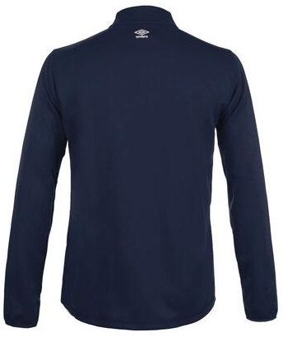

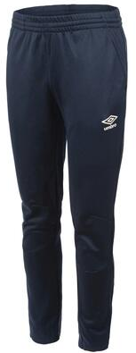
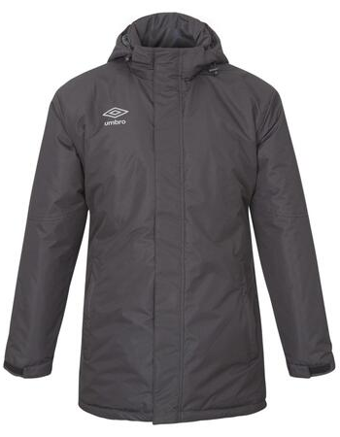
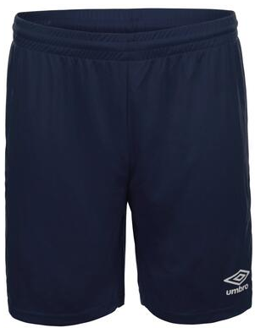
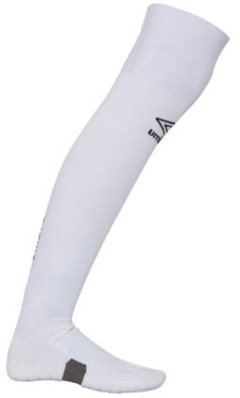
Träningskläder
AA
AA
Cup jsy
SR 231006A 194:-
JR 231006J 194:-
Liga ¼ Zip
Sr 231000A 489:-
Jr 231000J 454:-
AA
Liga Pant
Sr 231002A 314:-
Jr 231002J 279:-
Core Sock
171101810 90:-
30/34,35/39
40/44,45/48
Cup Shorts
Sr 231007A 189:-
Jr 231007J 189:-

Slide 2
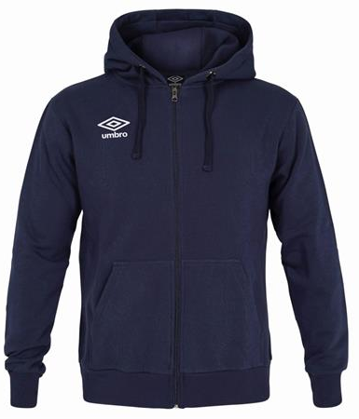
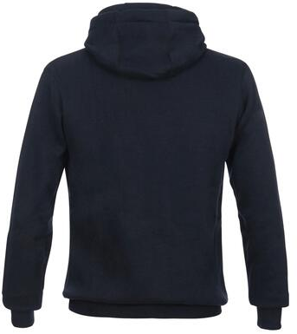
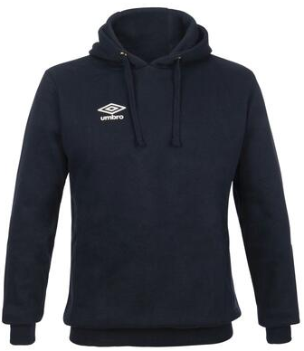
Hood zip
201008A Sr 404:-
201008J Jr 369:-
Hood
201013A Sr 369:-
201013J Jr 334:-

Slide 3
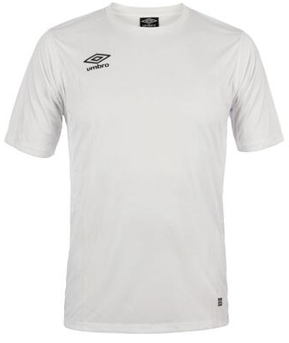
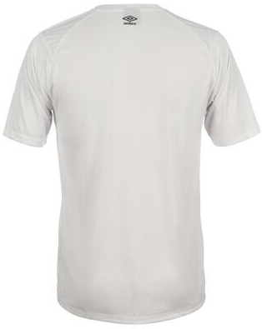
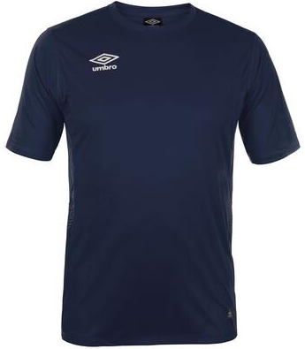
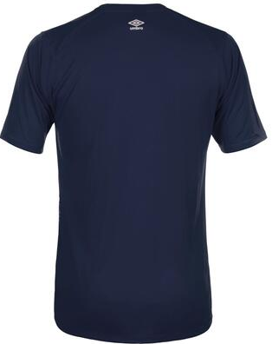
9
9
9
9
Liga Jsy Innebandy
SR 231003A 359:-
JR 231003J 324:-
9
9
Liga Jsy Fotboll
SR 231003A 314:-
JR 231003J 279:-

Slide 4
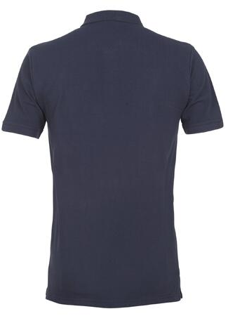
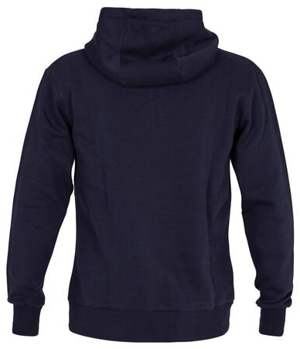
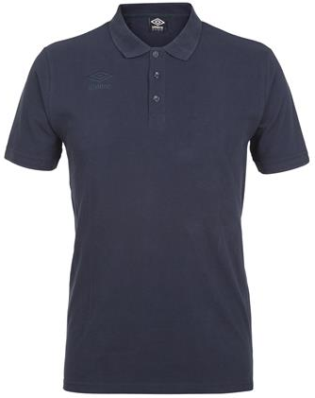
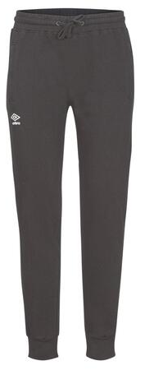
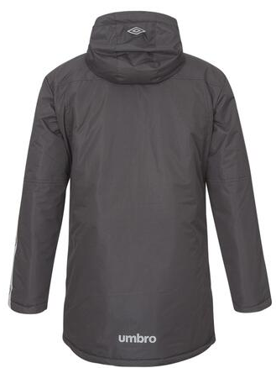
AA
Hood zip
201008A Sr 453:-
201008J Jr 418:-
Core Polo
171103A Sr 334:-
UX Elite Team Jkt
201231A Sr 1013:-
AA
Basic sweat pant
192025A Sr 279:-
192025J Jr 244:-
Hood
201013A Sr 418:-
201013J Jr 383:-

Slide 5
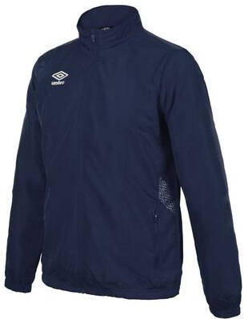
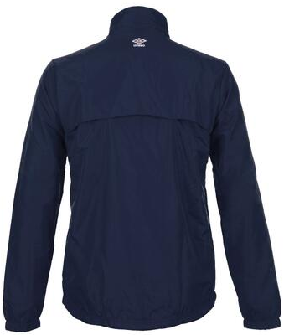
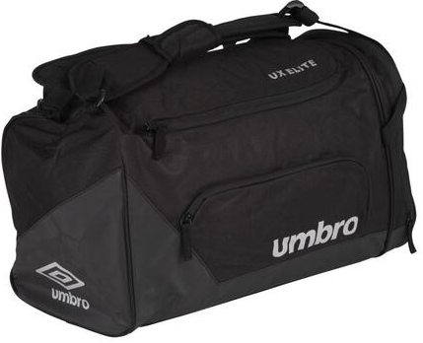
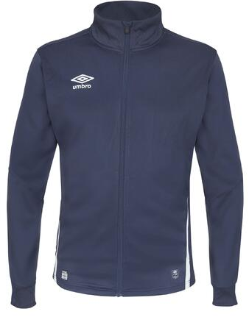
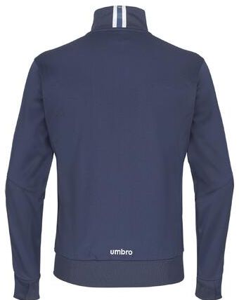
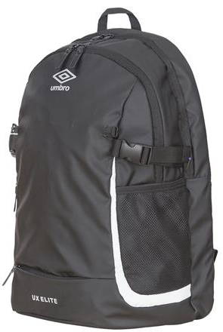
Liga Tr Jkt
231001A Sr 593:-
AA
Umbro UX Elite Bag S ( 40 L )
202037980S 434:-
UX Elite Tr jkt ( WCT )
201226A Sr 663:-
AA
Ej webb
Umbro UX Elite Backpack
202041980L 399:-

Slide 6
AA
AA
AA
AA
Lilla Paketet
SR + Jr 424:-
Stora Paketet
SR 1177:-
JR 1107 :-

