Slide 1
Bowling Technique

Slide 2
ETBF Methodology: Our base Concept ETT
Everything Towards the Target
ETBF programs shape around the concept of ETT – Everything towards the target where target is the intended target line.
    ETT is shaped with three main movements:
WTT
Walk towards the Target
ETT
STT
Swing towards the Target
RTT
Release towards the Target

Slide 3
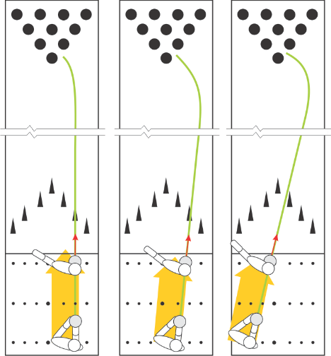
ETBF Methodology: Our base Concept ETT
Everything Towards the Target
WTT
Walk towards the Target
STT
Swing towards the Target
RTT
Release towards the Target

Slide 4
ETBF Methodology: ETT & Four Focus Areas
ETBF programs teach bowling with four main topics in relation to ETT concept
ETT
SWING
TIMING
STEPS
BODY ANGLES
Notes:
Era tankar om de här slidsen. 203-207.
Era erfarenheter?

Slide 5
Mobility and stability in the body
You need to have mobility and stability in the right places in your body
Otherwise you body will not work right!
  Feet: stable
  Ankle: mobile
  Knees: stable
  Hips: mobile
  Lumbar spine: stable
  Thoracic spine: mobile
  Scapula: stable
  Cervical spine: stable
  Shoulders: mobile
  Elbows: stable
  Wrists: mobile
Notes:
Vilka delar ska vara rörliga och visa stabile!
Kroppen kompenserar!

Slide 6
ETBF Methodology: Our Workflow of Teaching from Scratch
SWING
Swing concept
Swing with the body
Use of Non-Bowling arm
Swing Start
ETBF Programs start with SWING concept then go to TIMING, STEPS, and BODY ANGLES.
TIMING
Timing Concept
Timing Points
Timing Check Points
Timing Effects
STEPS
Step Channels
Step Sizes
Step Tempo
Step direction and type
BODY ANGLE
Personal Angle
Comfortable stance
Release Position – 3rd Step
Release Position – 5th Step
Notes:
Introduktionssida!
Gå igenom vad som ska gås igenom, mer detaljer senare!!

Slide 7
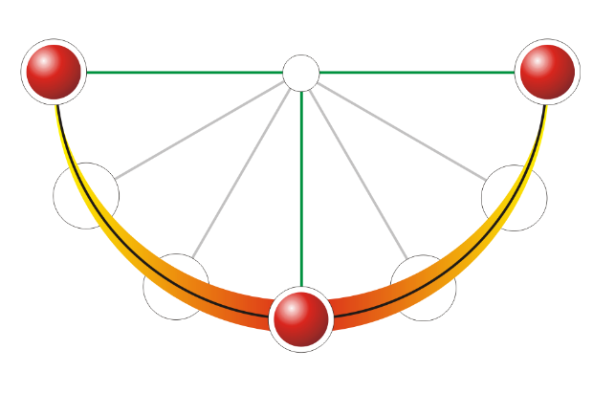
Understanding Free Swing & Speed of Ball
SWING ACTION
STOP
STOP
SLOW
SLOW
FASTER
FASTER
FASTEST
Notes:
Skateboardrampen

Slide 8
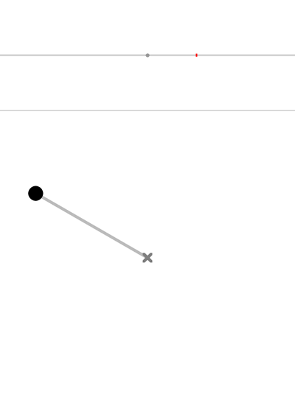
Understanding Free Swing & Speed of Ball
SWING ACTION
STOP
STOP
SLOW
SLOW
FASTER
FASTER
FASTEST

Slide 9
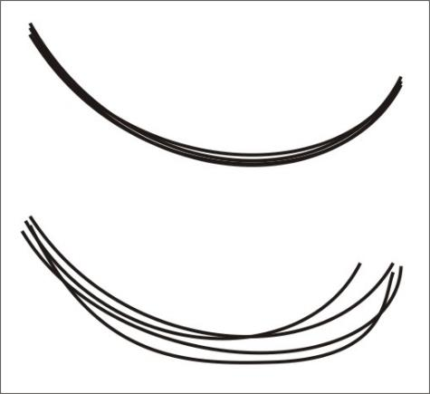
Swing Shape
Swing Controls
Good Swing
Check the height of the back swing and the repetition of the swing curve.
Check the speed pattern of the swing.
Bad Swing

Slide 10
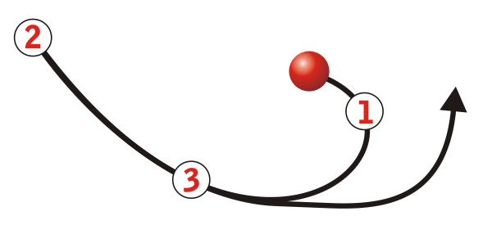
Swing & Grab
Popular Grabbing points at the swing:
Right side view of bowler’s armswing.
The results of excessive grip pressure:
1. Grabbing the ball in the hinge will delay the arm swing, causing late timing.
2. Grabbing the ball at the top will cause the player to pull down from the top, causing a weak release.
3. Grabbing the ball in the forward swing will cause the player to hit up on the ball, causing no flat spot.

Slide 11
5-Step Approach with three channel concept
S
1
2
3
4
5
F
Notes:
Huvud och klot i den högra kanalen I hela ansatsen
Svinglinje handlar bara om svinglinjen
Andra steget viktigt för resten av ansatsen!

Slide 12
5-Step Approach with three channel concept
S
1
2
3
4
5
F
STEP SIZE
REGULAR
REGULAR
LONG
SHORT
LONGEST
TEMPO
SLOW
SLOW
FASTER
QUICK
Notes:
Stegen tas naturligt under viktcentrum (center of gravity)!!

Slide 13
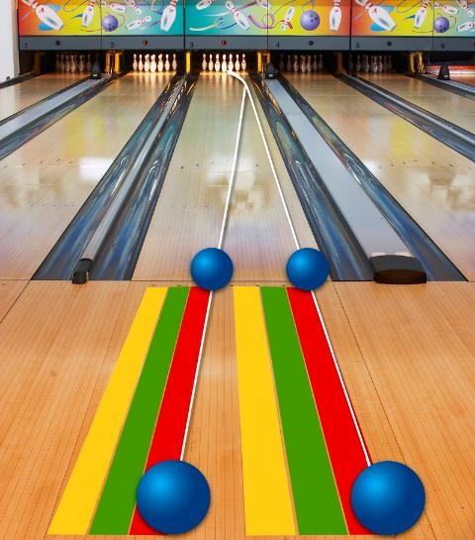
5-Step Approach with three channel concept
Notes:
Visualisering av ETT I “praktiken”!!

Slide 14
5 Step Approach
STANCE DISTANCE
To find out where to start at the approach let your bowlers do the exercises with normal steps and try to find the natural 5-step distance without trying to reach the foul line.
Then you can adjust the starting point according to your bowlers natural 5-step length.
REMEMBER: Most bowlers start so far from the foul line and then use unnatural bigger steps to reach foul line that causes timing problems and unnecessary speed.
NATURAL DISTANCE
1
3
2
4
5
5
BOARD CALCULATION
There are many definitions of defining the board the bowlers start or stand as side of the shoe, toe of the show, center for the shoe, etc.
For unity in coaching ETBF programs use the inner side of the shoe (left shoe for right-handers and right shoe for left-handers) and the board it covered for defining the board that bowler stands.
The bowler here is a righthander bowler standing on 20th board.
Notes:
Prova den naturliga promenadtakten med blicken framåt.

Slide 15
ETBF Methodology: Our base Concept ETT
Everything Towards the Target
WTT
Walk towards the Target
STT
Swing towards the Target
RTT
Release towards the Target
Notes:
Sving
Ansats
Släpp

Slide 16
Stance
Place your head above the little toe on your push off foot (front - rear view) to begin establishing a vertical balance plane for your body, and the trajectory of the ball.
Modern Stance
Classic Stance
Front view of right hander;
Rear view of left hander

Slide 17
Release Position
Bowlers must maintain balance at the finish and do not fall off (check the sliding foot position)
Their heads must be in vertical line with the position the ball was at the release.
Try to keep your bowlers’ balance until the ball hits the pins. This is a good check for balance, and allows for bio-feedback (good learning tool).
Rear view of right hander
Front view of left hander

Slide 18
Release Position
Modern Game
Classic Game
Rear view of right hander
Front view of left hander
Rear view of right hander
Front view of left hander

Slide 19
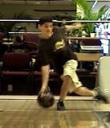
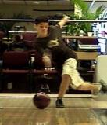
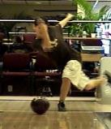
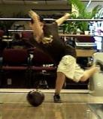
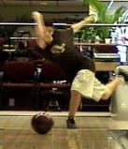
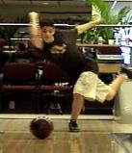
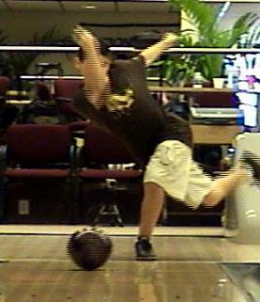
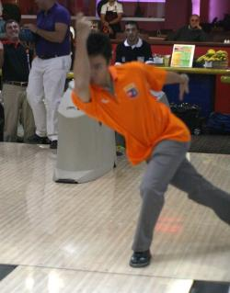
Release Position with Inside Out Action
Elbow position after release

Slide 20



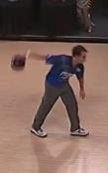

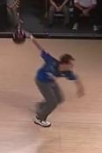
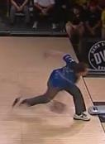
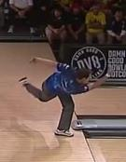
Timing Check Points and Control Points 1-2-3
TIMING
Point
1
TIMING
Point
2
TIMING
Point
3
CHECK
Point
1
CHECK
Point
2
CHECK
Point
3
STANCE
1 STEP
Right hand must start to move when the left foot sole touches the floor.
Step must be slow
2nd STEP
The Ball must be at a down motion when the right foot heel is touching the floor.
Step must be slow.
3rd STEP
Check the position of the ball when ball is at the bottom. The ball and the legs must be aligned.
Check the ball position when the step is over. The ball must be at the PROZONE (the zone behind the leg and waist)
Step must be normal
4th STEP
The Ball must be at the top of the swing and stop moving.
Step must be quick
When two steps are together the ball has to start down swing
5th STEP
Down Swing
Slide
Release
Trailing leg must wait till all the weight is transferred to last step and last step stops sliding.
Follow
Through
When the foot stops the ball has to be behind the ankle.
Notes:
Timing – Body angles - release
In order to produce a smooth effortless approach we need a certain timing to let the work together with the swing.
Scheme from stance to the foul line.
på Timingpunkterna (Helheten) Visa 1+2 och förklara 3
Checkpunkter, visa 1+2+3
Text för varje steg! Detaljer!
Se “suddigheten” I bilderna för relativ hastighet.

Slide 21
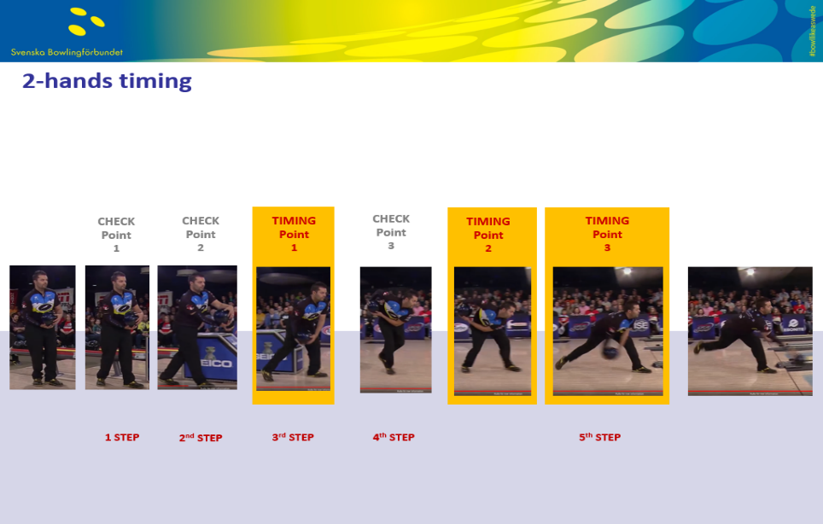

Slide 22
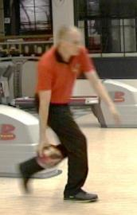
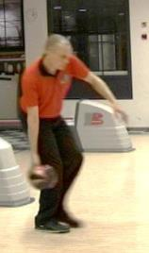
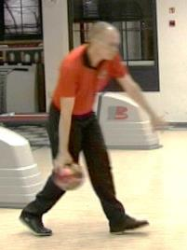
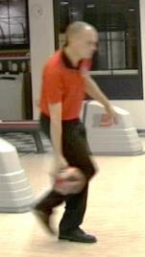
Timing points: Timing Point 1
Timing Control Point 1 is the position when the bowling arm is at the bottom of the swing during the backswing. According to that position we look at the steps and define how early or late the bowler has started their timing. When we say “One Step Late Timing” we refer to Timing Point 1 at the start of the swing in ETBF programs.
Half Step Early
OPTIMAL
Half Step Late
One Step Late
Notes:
Timingpunkt 1
När klotet är lodrät I baksvingen skall tredje stegets fot passera andra stegets fot.
När vi pratar om “sen timing” så refererar vi till den här positionen.

Slide 23
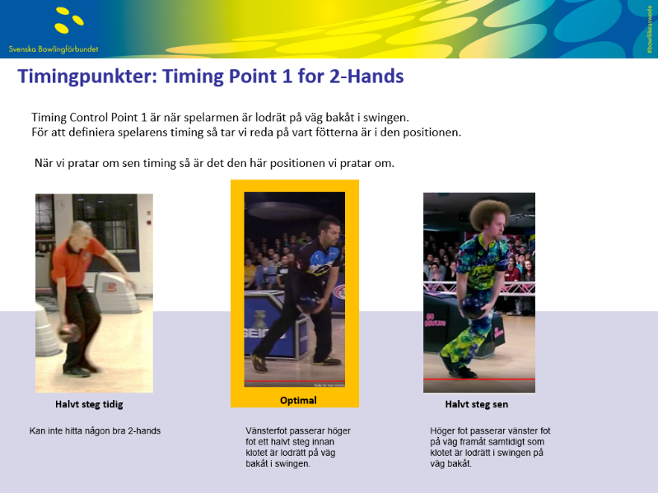

Slide 24
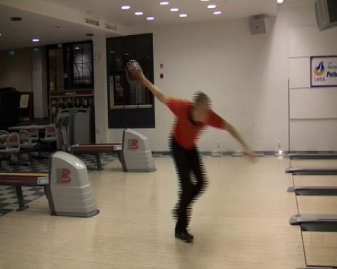
Timing points: Timing Point 2
Timing point is measured when the downswing starts (when the angle of the bowling arm and the body side starts to close down
We would like to see both feet side by side as the bowler is taking the last step
Timing Point 2 shows us if the swing motion is correct and the ball moves down with gravity or the bowler pulls down the ball.
Notes:
Timingpunkt 2 mäts när nedsvingen startar.
I optimal timing så skall Glidfoten vara parallel med den andra foten.
Timingpunkt 2 visar om klotets nedsving startas av gravitationen eller inte.

Slide 25
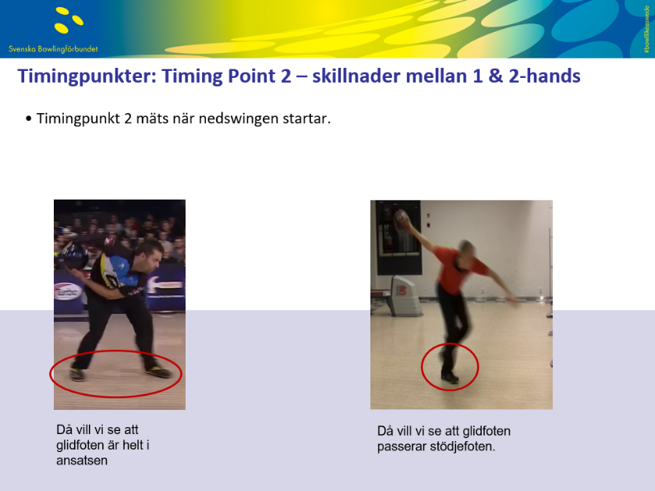

Slide 26
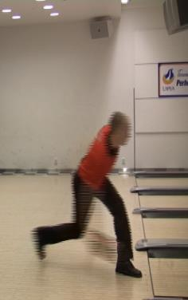
Timing points: Timing Point 3
Timing point 3 is measured when the slide ends
For beginner and intermediate bowlers we like to see the ball approximately ½’ – 1 ½’ from the ankle of the foot
For advanced bowlers we check whether the ball is in different position with different types of play
  In front of the foot with smaller rev´s and straight line
  Sometimes even 3-4’ behind the ankle with maximum rev´s from deep inside
  Even with very advanced bowlers we don´t practice to change Timing point 3, just check if the changes are there
Notes:
Timingpunkt 3
When foot stops
Beginner ½ to 1 foot behind ankle
Advanced depends on how they attack
Mäts när foten stannar.
För nybörjare – klotet bakom ankeln ½ - 1 ½ fot.
Mer avancerade – beror på spellinjen
Hårt och rakt – vid ankeln
Djupt inne – 3-4 fot bakom ankeln

Slide 27
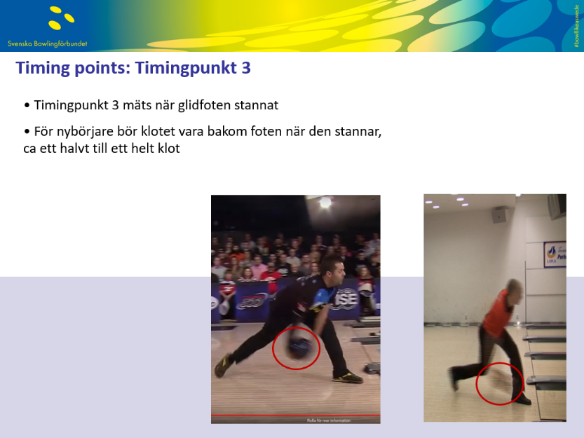

Slide 28
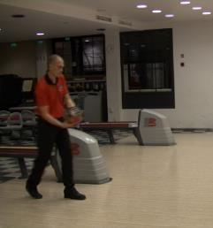
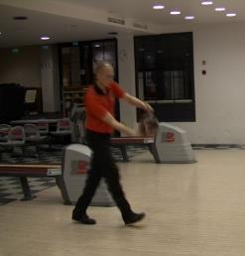
Timing points: Check Points 1-2 > Timing Point 1
Check Point 1
  The swing should start when the toes of the first step touches the approach (solid support)
Check Point 2
  When the heel of the second step touches the approach the ball should already be on a downward motion
CHECK POINT 1
1st STEP
CHECK POINT 2
2nd STEP
Notes:
Check point 1&2
Tool to get to timing point 1
If it aint broken – don’t fix it!!
Gå igenom 1 & 2.
Kom ihåg – om timingpunkt 1 är på plats, ändra inget!

Slide 29
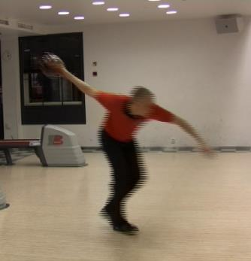
Timing points: Check Points 3 > Timing Point 2
Check Point 3
  4th step should be on the approach when the ball reaches the top of the swing
CHECK POINT 3
4th STEP
Notes:
Checkpunkt 3
Ball should be at top of backswing.
Näst sista steget (4:e) skall vara på ansatsen när klotet når toppen av baksvingen.

Slide 30
Timing
Perfect Timing:
Perfect timing differs from person to person, style to style. Timing is defined as where your ball and arm are when your foot enters (starts) the slide. You have to give references to basis of the timing for your bowlers to check their timing.
These are the older definitions of timing. When we look at today's good bowlers we see more late and early timing than “perfect” according to those definitions.
Today timing is also a variable that good bowlers change during the game.
When you talk about the timing you have to be clear “which” part of timing you refer.
Early Timing
Early timing occurs when your ball is at the release point (in front of your body) before your slide begins. This is a very weak position to release and the bowlers usually pull the ball without a good balance. The ball usually misses to the left or toward the middle of the lane.
Slowing down the begginning of the 4 step approach, or having a higher back swing usually helps early timing.
Late Timing
Late timing is the opposite of early timing as the arm and the ball is still at the top of the backswing stage or late in downswing when the body is approaching the faul line. The ball usually misses to the right or towards the channel.
Working on different ball path and prozone, unmuscling the swing or a shorter backswing usually helps late timing.
For all timing issues proper ball fitting is very important for consistency and swing-trust of the bowler.
Notes:
Old definitions (USBC)
Today – later and changing depending on line of play and desired ball speed.
Always be clear on which timing you refer to.
Här är några äldre formuleringar som vi inte längre använder ( I Europa)
Kom ihåg: vilken del av timing pratar vi om???
Nu förtiden för tenderar de bra spelarna att var senare till mycket senare än detta!
I dagens spel varierar timingen beroende på hur spelarna vill spela för stunden.

Slide 31
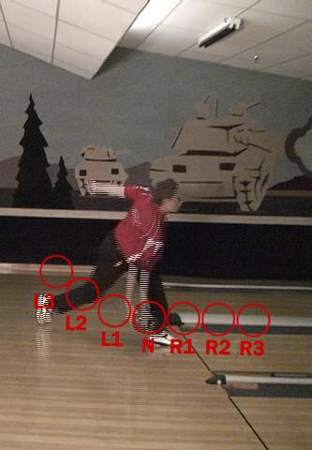
5 Step Approach: Timing Definitions
Timing definitons are based on the The ball position when the foot stops sliding.
Leverage
Neutral
Roller
Notes:
USBC again.
Doesn’t really tell anything about style of play.
Definitioner (som jag ärligt talat inte vet vad vi ska använda till) baseras på klotets position när foten stannar.
USBC:s definition av sperlstil
Men det säger egentligen inget om spelstil..

Slide 32
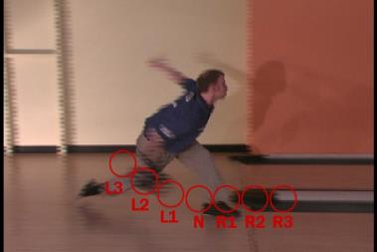
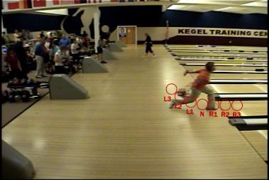
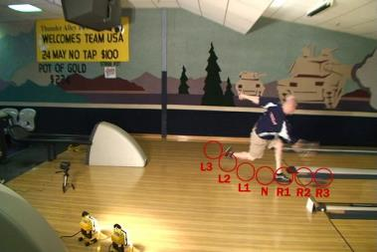
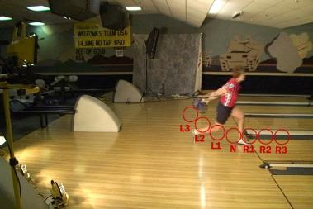
5 Step Approach: Timing Definitions
Notes:
?????
Timingpunkt 3 beror på hur du attackerar banan.
TJ – ena bilden L2 andra bilden R3
Tjej uppe L2
Tjej nere L3
säger det något om spelstil? NEJ.

Slide 33
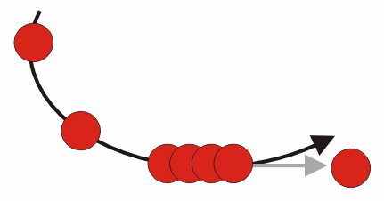
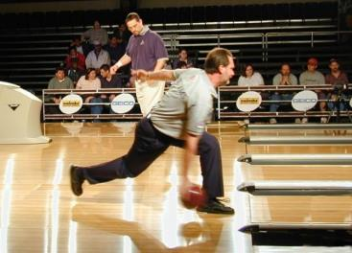
Bowlers Analysis: Observation
The “Flat Spot”
The portion of the arc of the arm swing from the ankle forward, where the fingers are parallel to the lane.
The ball direction must be parallel to the floor before the release – as a plane landing. If the ball has a lifting action the bowlers may loose power and accuracy with a gripping action.
Notes:
Myten “Flat Spot”…
Vi pratar om det för att vi kommer möta det I vår roll som tränare.
Fingrarna är INTE parallella med anstatsen..
För att få klotet att gå parallellt med ansatsen så ,,,, visa mot en bordskiva..

Slide 34




Body Angles
Body angle throughout the approach is crucial to provide necessary area for swing and the ball. In order to provide the balanced and solid position at the foul line where head is above the ball and swing arm is straight the bowler should generate enough angle during the approach to keep his position.
Our research show that most of the top bowlers get their body angles at the end of 3rd step of 5 step around 45-65 degrees and mostly keep this angle until the end of their approach (max 5-8 degree differences)
This is the reason we call the end of 3rd step as "release position" where a bowlers sets everything required for a proper release position.
Notes:
RELEASE POSITION
Create release position at the end of (during) the third step.
Correct body angle is enough to keep a straight swing directly under your head in the intended playing line. (swingbox)
Keep until release

Slide 35
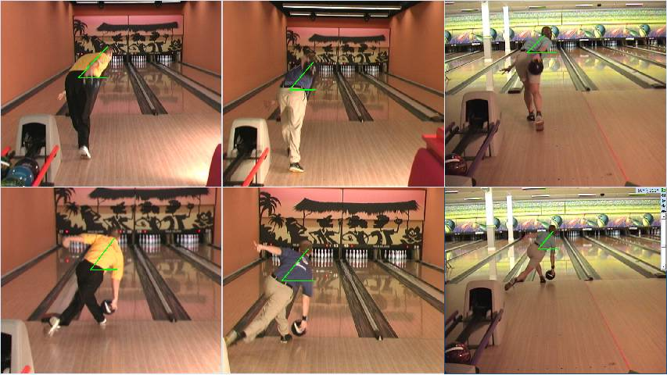
Body Angles and Heights
48
49
47
49
48
47
Bowlers usually get their body angle between 35 and 55 degrees though their 3rd step to get ready for the finish position.
Notes:
Note the players keeping the body position from the third step.
Less than a 8 degree difference.

Slide 36
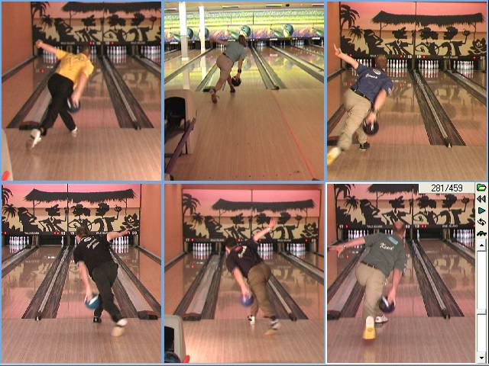
Body Position before the release
Ball follows a path from inside out to get the proper release position under the head.
Notes:
Ball goes inside out to keep it under the head

Slide 37
5 Step Approach: Body Angles - Hip Height – Stable Shoulder
According to our analyses, top bowlers fix their body angles at the end of the 3rd step. They also fix their height at the 4th step and make themselves ready for the last sliding step. The 5th step carries that angle and height to foul line.
Notes:
Not only the body angles but also the hight is fixated during the 3rd step.
Do we fix this pic. To a player that actually does that?

Slide 38
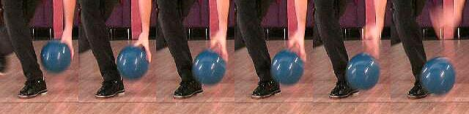

Release
A release is a smooth action of wrist and fingers. It requires “a releasing” movement instead of muscling and gripping.
For a proper release the bowler need to have a good swing and timing to provide the best balanced position for any kind of release. In a proper release there are three stages:
Thumb Release
Fingers and Wrist Rotates around the ball (Not the arm)
Fingers Release Comfortably – NO MORE LIFTING ACTION – OR FEELING THE BALL AT THE FINGERS
Notes:
Its called a release for a good reason – that is just what it is.. Release it in a smooth action of the wrist and fingers.
3 stages of release (after the arm and wrist is straightened)
Thumb release at bottom of swing
Fingers and wrist rotates around the ball (not the arm)
Fingers release comfortably – no lifting action but forward.
Use gravity as your friend!
Practice slow enough with light enough equipment to manage – then increase speed!

