Slide 1

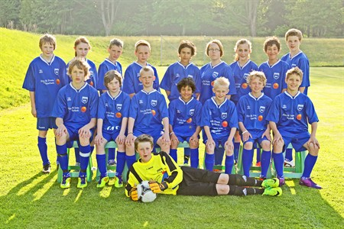
Blentarps P99 performance
2011 - 2012

Slide 2
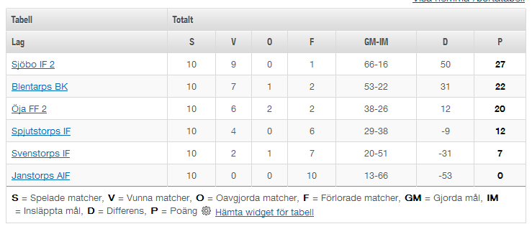
P12 Sanktan Sö B, vår 2011

Slide 3
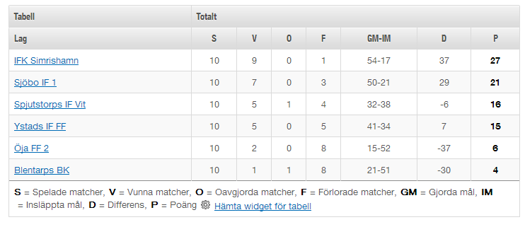
P12 Sanktan Sö A, höst 2011

Slide 4
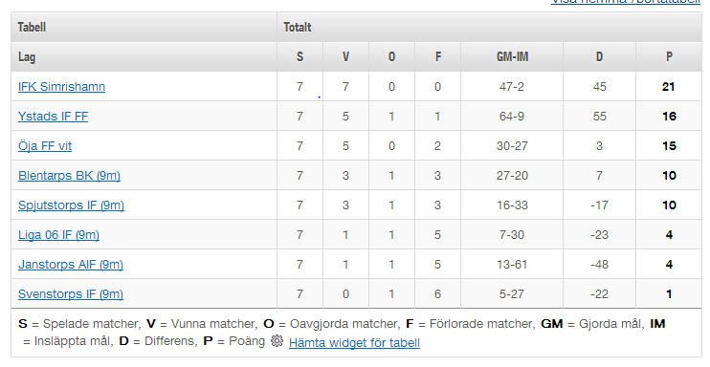
P13 Sanktan Sydöstra A, vår 2012

Slide 5
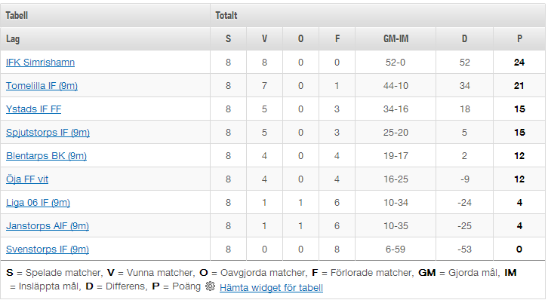
P13 Sanktan Sydöstra A, höst 2012

Slide 6
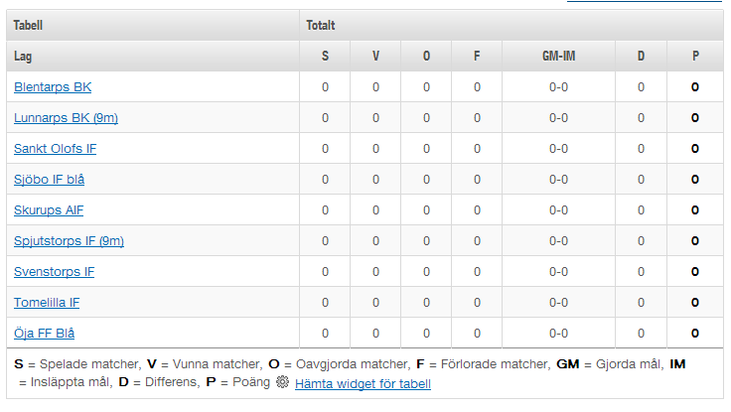
P14 Sanktan Sydöstra A, vår 2013

Slide 7

Summary
 | Höst 2011 | Vår 2012 | Höst 2012 | Vår 2013
Games played | 10 | 7 | 8
Won | 1 | 3 | 4
Drawn | 1 | 1 | 0
Lost | 8 | 3 | 4
Points | 4 | 10 | 12
Points per game | 0.4 | 1.4 | 1.5
Goals scored per game | 2.1 | 3.9 | 2.4
Goals conceded per game | 5.4 | 2.9 | 2.1
Goal difference per game | -3.3 | +1.0 | +0.3

Slide 8
Summary
After being promoted from the B to the A league in 2011, the P99 have consistency improved
Goals scored per game has been level
  2.1 vs. 2.4 (höst 2011 –vs. höst 2012)
Points per game has increased
  0.4 vs. 1.5 (höst 2011 – höst 2012)
Goals conceded per game has decreased
  5.4 to 2.1 (höst 2011 – höst 2012)

Slide 9
Key factors for improvements in 2012 (1)
Increased focus on defending
  Defending drills has been a key feature of training sessions
    Positives
      Marking, tracking back, ‘staying goal side of the attacker’ and defining the responsibility for each player
    Negatives
      Lack of communication between defenders and between defenders & goalkeeper

Slide 10
Key factors for improvements in 2012 (2)
Lack of ‘power’ up front
  The P99 team is a relatively ‘small’ team, lacking big strong players to ‘boss’ the opposing defenders
    Focus areas to address this issue
      Increased use of the body to keep the ball
      Need to be more aggressive on and off the ball
      Continued focus on running off the ball to beat the marker & make space
        ‘get, give, go’

Slide 11
Key factors for improvements in 2012 (3)
Fitness is making a difference
  The P99 team is generally much fitter compared to previous years
    In many games the P-99 team has finished the game strong
    Need to continue on fitness drills, but focusing on football fitness drills and not just running

Slide 12
An issue for 2013
The P99 team has lost a couple of players in 2012
  One moving to Veberöd (Marre) and another stopped playing (Oliver)
In 2013, the P99 team will lose another player, Felix to Lund.
  The key reason for this is that Felix would like to compete at a higher level with players his own age (welcome back anytime ☺)
Unfortunately, we lack new players joining to replace those players that have left or will leave.

