Slide 1
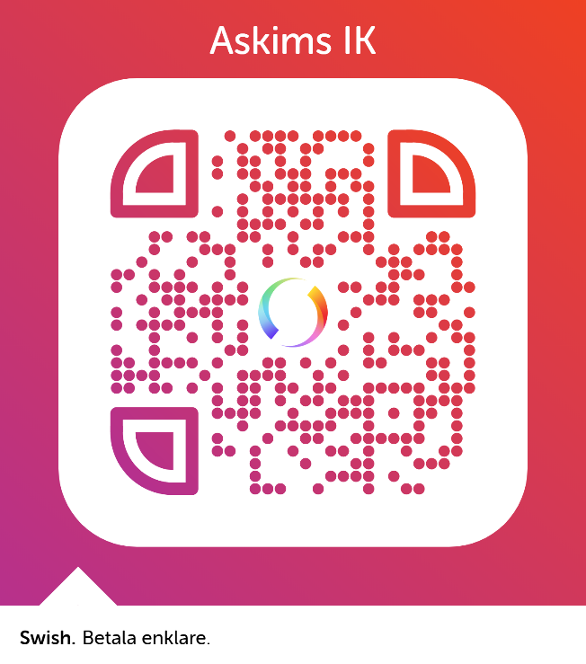
Välkommen!
Kaffe .......................................................... 20:-
Te ............................................................... 15:-
Läsk/Mineralvatten (33cl)............................ 20:-
Festis .......................................................... 15:-
Smörgås ...................................................... 20:-
Kexchoklad .................................................. 15:-
Frukt ........................................................... 10:-
Kaka (hembakat/bulle etc)........................... 20:-
Liten kaka................................................... 10:-
QR-kod till digitala lagkassan för ert lag.
Tack!

